Slide 1


Department of CS & IT
CyberCrime Ontology

Slide 2
Department of CS & IT
Our Team
Syeda Moaddat Naqvi
Team Leader
BSSE REG-7th
CAPSTONE PROJECT-1
2019-2023
syedamoaddatnaqvi141@gmail.com
BSEF19M005
Anam Razaq
Team Member
anamrazaq236@gmail.com
BSEF19M003

Slide 3
Department of CS & IT
Mr.Fahad Maqbool
Project Supervisor
Assistant Professor
fahadmaqbool@uos.edu.pk

Slide 4
Department of CS & IT
AGENDA
Introduction
Background
Justification
Purpose
Tools
Methodology
References
BSSE REG-7th
CAPSTONE PROJECT-1
2019-2023

Slide 5
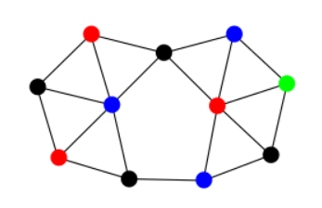
Department of CS & IT
INTRODUCTION
Ontology provides explicit specification of
conceputalization.It combines data coming
from different domain.
CyberCrime ontology will provide interoperability
by allowing data to be linked at semantic level.

Slide 6
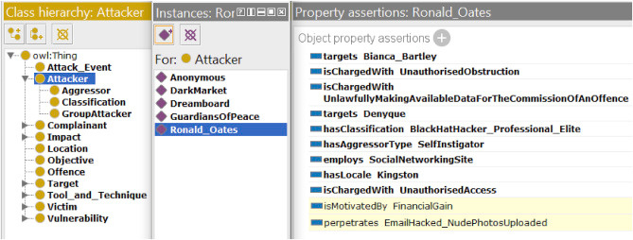
Department of CS & IT
BACKGROUND
The ontology work related to
CyberCrime done is only about
the CyberCrime classification.

Slide 7
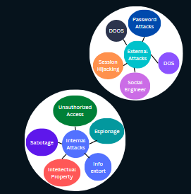
Department of CS & IT
JUSTIFICATION
Our CyberCrime ontology project
will be limited to CyberCrime attacks.
It will consists of different types of attacks
like internal and external attacks.

Slide 8
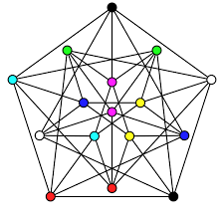

Department of CS & IT
PURPOSE
The main purpose of this ontology is to
provide a platform of information to those
who are novice to this field or have no
knowledge of CyberCrime and
their impacts.

Slide 9
Department of CS & IT
TOOLS
Protege
Web-vowl
WIDOCO

Slide 10





Department of CS & IT
METHODOLOGY
1
2
3
4
5
Data Extraction and transformation
Data Consolidation
Ontology Development
Ontology Refining
Summarizing and publishing Results

Slide 11
Department of CS & IT
REFERENCES
Charlette Donalds, Kweku-Muata Osei-Bryson,Toward a cybercrime classification ontology: A knowledge-based approach,Computers in Human Behavior,Volume 92,2019,Pages 403-418,ISSN 0747-5632,
International Journal of Accounting Information Systems, Volume 38, September 2020, 100467
Phillips, K.; Davidson, J.C.; Farr, R.R.; Burkhardt, C.; Caneppele, S.; Aiken, M.P. Conceptualizing Cybercrime: Definitions, Typologies and Taxonomies. Forensic Sci. 2022, 2, 379-398

